Slide 1
Simulating test track in SUMO
Wushuang Bai

Slide 2
The purpose of this presentation is to show how to simulate Penn State test track in SUMO.
Input:
TestTrack_Basic.net.xml : this is the network definition
TestTrack_Basic.rou.xml : this is the route definition
TestTrack_Basic.sumocfg: this is the simulation configuration
Output:
NA. Note that the purpose of this presentation is to show the simulation. For exporting simulation results, there is another document to explain. Please see https://github.com/ivsg-psu/TrafficSimulators_GettingStartedWithDifferrentSimulators_GettingStartedWithSUMO/blob/main/Documents/How%20to%20export%20SUMO%20simulation%20results.pptx

Slide 3
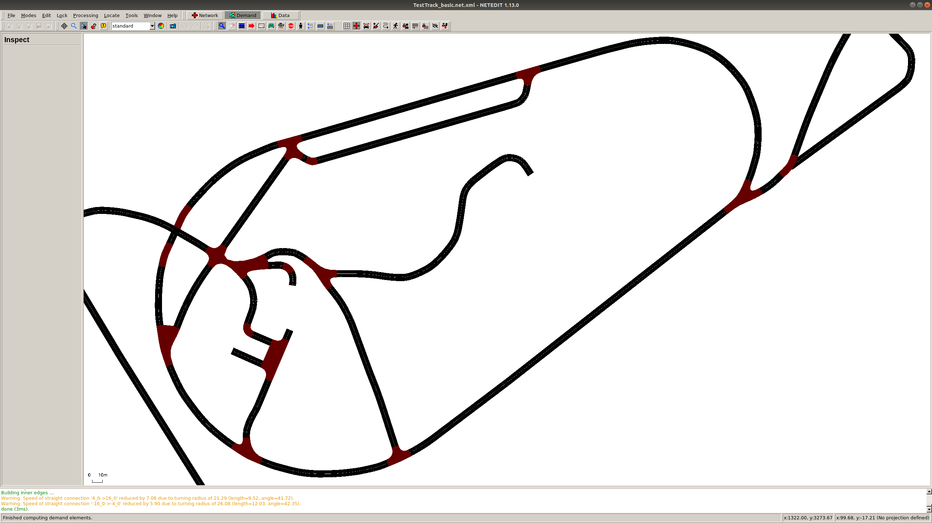
Test track map(in .net.xml) in SUMO is shown as below:

Slide 4
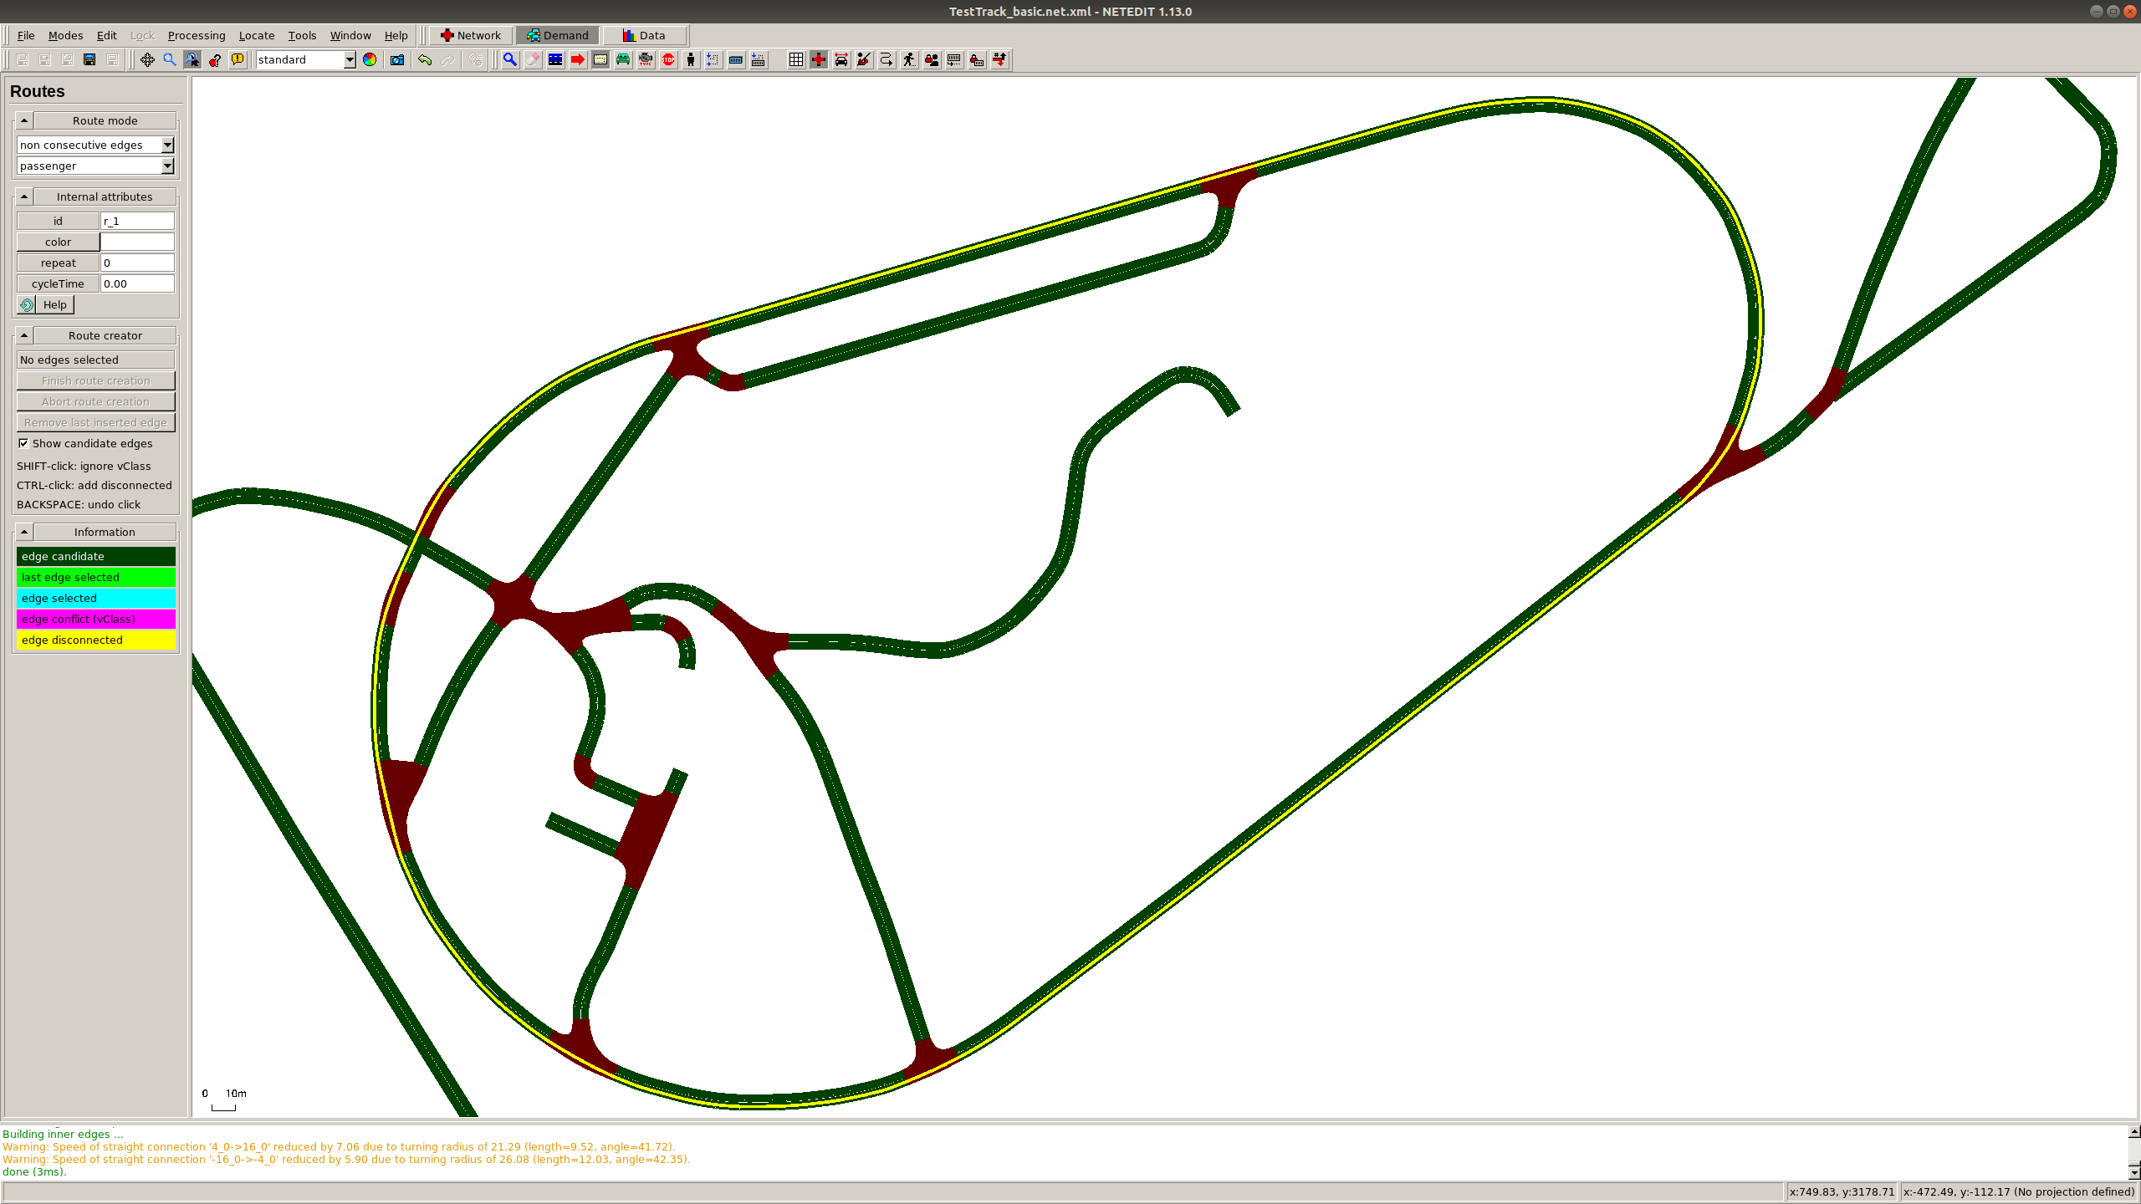
The route (in .rou.xml) is shown as below:

Slide 5
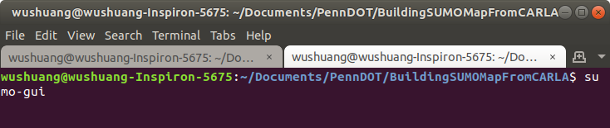
Open a terminal, run "sumo-gui" to open SUMO.

Slide 6
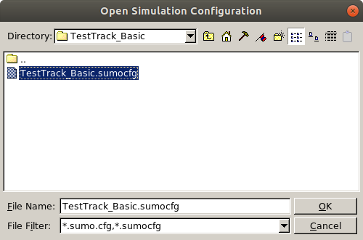
Click File->Open simulation -> TestTrack_Basic.sumocfg to load the simulation.

Slide 7
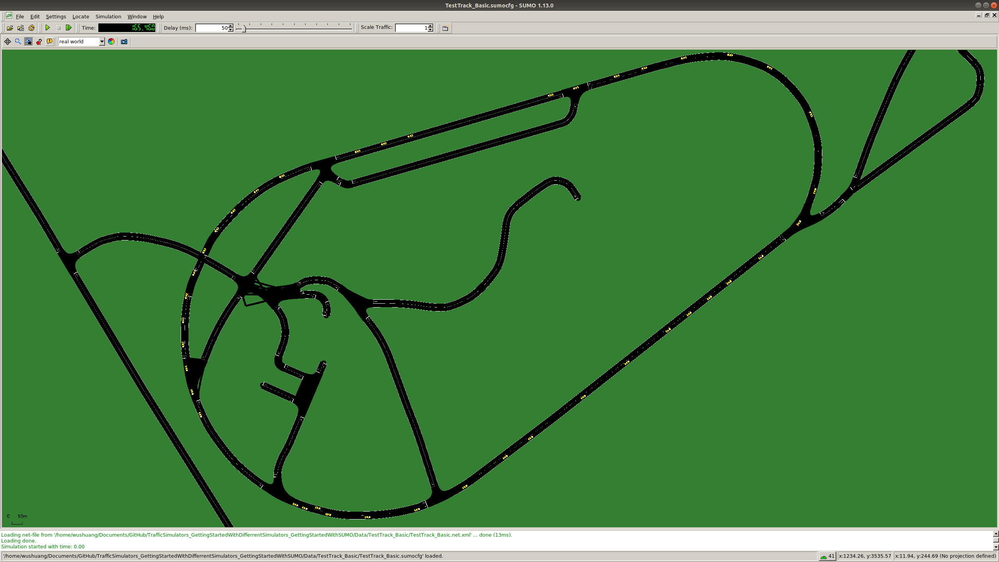
Click "Play" button to run the simulation, as shown below.

